Slide 1
House Prices Prediction
By Zhi Jiang

Slide 2

How to predict a house price?
Need to know some features of the house:
—number of bedrooms,
—total living area, etc
Some Features are more important than others:
—number of bedrooms > height of basement ceiling.

Slide 3
Machine learning model
Data Cleaning:
-Feature Selection
-Missing data
-Categorical features
Build Models:
-Select suitable models
-Model training
-Hyperparameter tuning
-Model evaluation
Prediction:
- Select best performed model
-Make house price predictions for new data

Slide 4
Data Cleaning

Slide 5
Data Set
Some of the Features
Ss
GrLivArea: Above ground living area
OverallQual: Overall material and finish quality
Bedroom: Number of bedrooms
YearBuilt: Original construction date
— train.csv
1460 data points,
79 features,
1 target, i.e. house price.
– test.csv
1459 data points,
79 features.

Slide 6
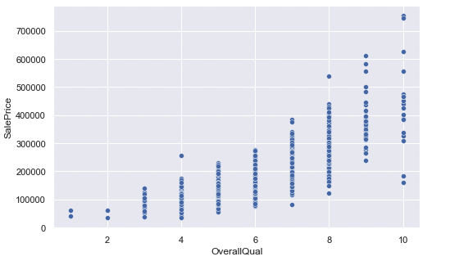
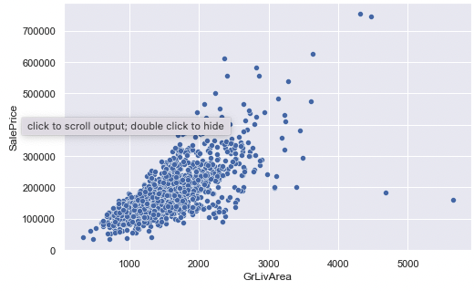
Data Exploration

Slide 7
Build Models

Slide 8
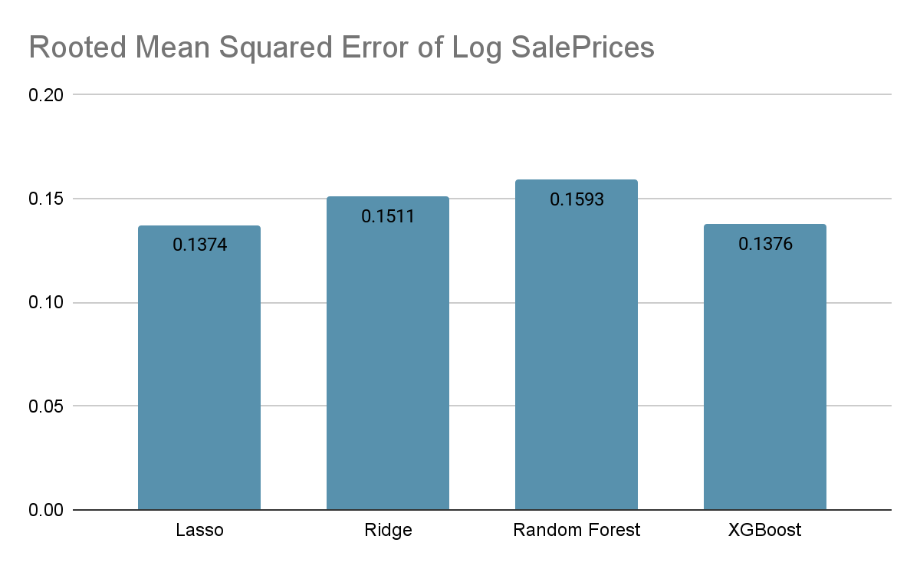
We select XGBoost as our final model to make predictions. It has low RMSE and runs pretty fast.
We also take Lasso Regression as comparison, as it also has pretty low RMSE.

Slide 9
Predictions

Slide 10
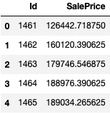
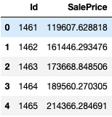
XGBoost
Lasso Regression
score:0.14546
score:0.15212

Slide 11
Conclusion
In this project, we analyzed the house price data set carefully, and build high performance machine learning model to predict the house prices.
We finally select XGBoost Regressor as our final model, as it has low RMSE and runs fast. We made predictions based on this model!

Slide 12
Thank you for attention

